Slide 1
SAI Demo 2016
OCP March 2016

Slide 2
Contributors Platforms and Requests
CONTRIBUTORS | NOS | ASIC | SWITCH | FEATURE REQUEST | SAI Version
DELL - 1 | DELL NGOS | BROADCOM T2 | DELL S6000 | PFC?, PTF?, ECMP | V0.9.3
MELLANOX – 1 + 1 | MNLX-OS | MELLANOX | MLNX Spectrum EN | ACL 5 tuple, PTF, ECMP | V0.9.3
BROADCOM - 1 | ICOS | BROADCOM T2 | DELL S6000 | PTF?, ECMP, PFC | V0.9.3
CENTEC - 1 | CENTEC OSP | CENTEC GG | CENTEC E580 | ECMP, PTF?, PFC? | V0.9.3
MEDIATEK - 1 | AS5512-54 | MTK ASIC | MTK+Estinet NOS | ECMP, PTF?, PFC? | V0.9.3
CAVIUM - 1 | MSFT ACS | CAVIUM | CNX880XX | PTF, ECMP, PFC | V0.9.3
BAREFOOT - 1 | MSFT ACS | Switch.p4 | SERVER | PTF, ECMP | V0.9.3
METASWITCH - 0 | MLNX-OS | MELLANOX | MLNX Spectrum EN | PFC?, ECMP | V0.9.3
MICROSOFT | MSFT ACS | BROADCOM T2 | DELL S6000 | PFC, PTF, ECMP | V0.9.3

Slide 3
Timeline 2016
March 8: Summit
March 3: Ship to Microsoft OCP volunteer
Feb 25th : Integration in Redmond
Feb 15th: Boxes shipped to starlab
Jan 25th: Decide on demo

Slide 4
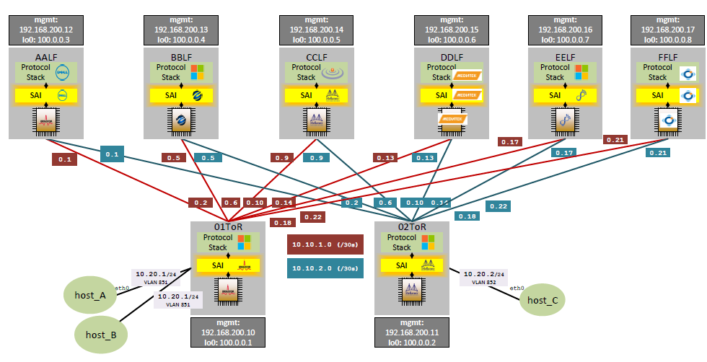
Topology

Slide 5
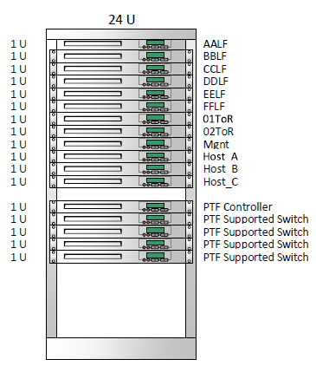
Rack

Slide 6
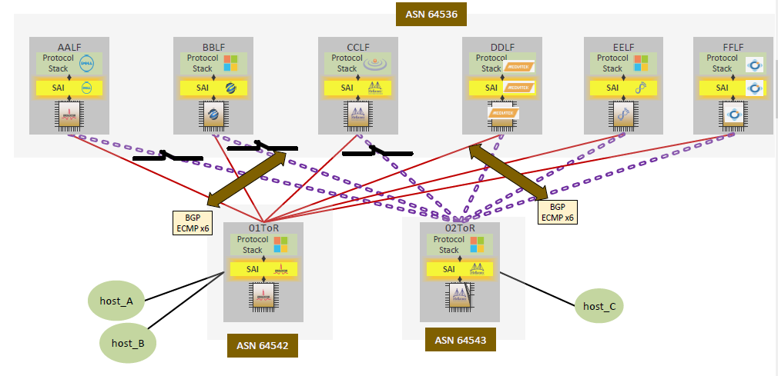
ECMP test case

Slide 7
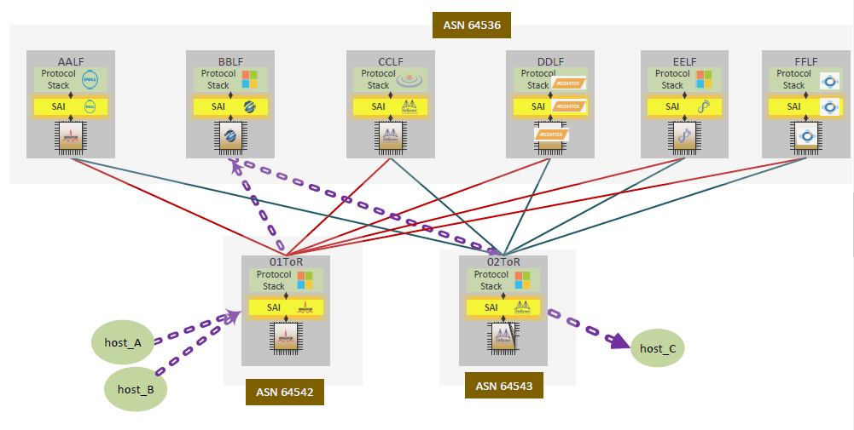
PFC with RDMA test case

Slide 8
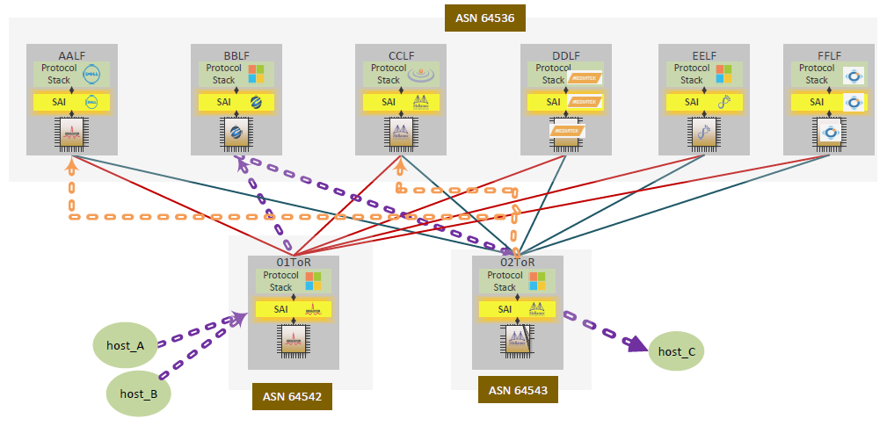
ACL 5-tuple test case

Slide 9
Protocol Test Framework (PTF) Test Case https://github.com/p4lang/switch/tree/master/tests/ptf-tests/sai-tests
SAI Compliance Test Suite: 1000 tests
==============================
MLNX: Executing test #501. Tests passed: 500. Failed 0
BRCM: Executing test #325. Tests passed: 324. Failed 0
CAVM: Executing test #673: Tests passed: 672. Failed 0
BFN: Executing test #158: Tests passed: 157. Failed 0
Action Item: Decide on the test cases

Slide 10
Show
BGP Routes
Counters/Port Stats
ACL permit/deny match/action (sai logs)
SAI calls
RDMA packets

